Slide 1
Selenium Basics and Overview
Poornima M
2025

Slide 2

INTRODUCTION TO BROWSER AUTOMATION

Slide 3
Browser automation means automating actions performed by a user in a web browser, such as:
Opening a website
Filling out forms
Clicking buttons or links
Navigating through pages
Validating displayed content
This is primarily used in testing web applications, data scraping, and repetitive web tasks.

Slide 4
OVERVIEW OF SELENIUM
Selenium is a popular open-source software testing framework used for automating web applications.
It is widely used for functional testing, regression testing, and performance testing.

Slide 5
WHY SELENIUM?
Reduces manual testing effort
Enables automated regression testing
Works across browsers and operating systems
Integrates well with tools like
Build tool-Maven
Test Framework-TestNG,JUNIT
CI/CD Pipeline- Jenkins,
Version Control-Git
BDD framework with Cucumber

Slide 6
HISTORY OF SELENIUM
The web automation framework Selenium originated in
2004
with the name of
"Selenium Core"
by
Jason Huggins
ThoughtWorks.
at
Over the years, it evolved through several key components and major version releases to become the widely-used, open-source standard for browser automation that it is today .

Slide 7
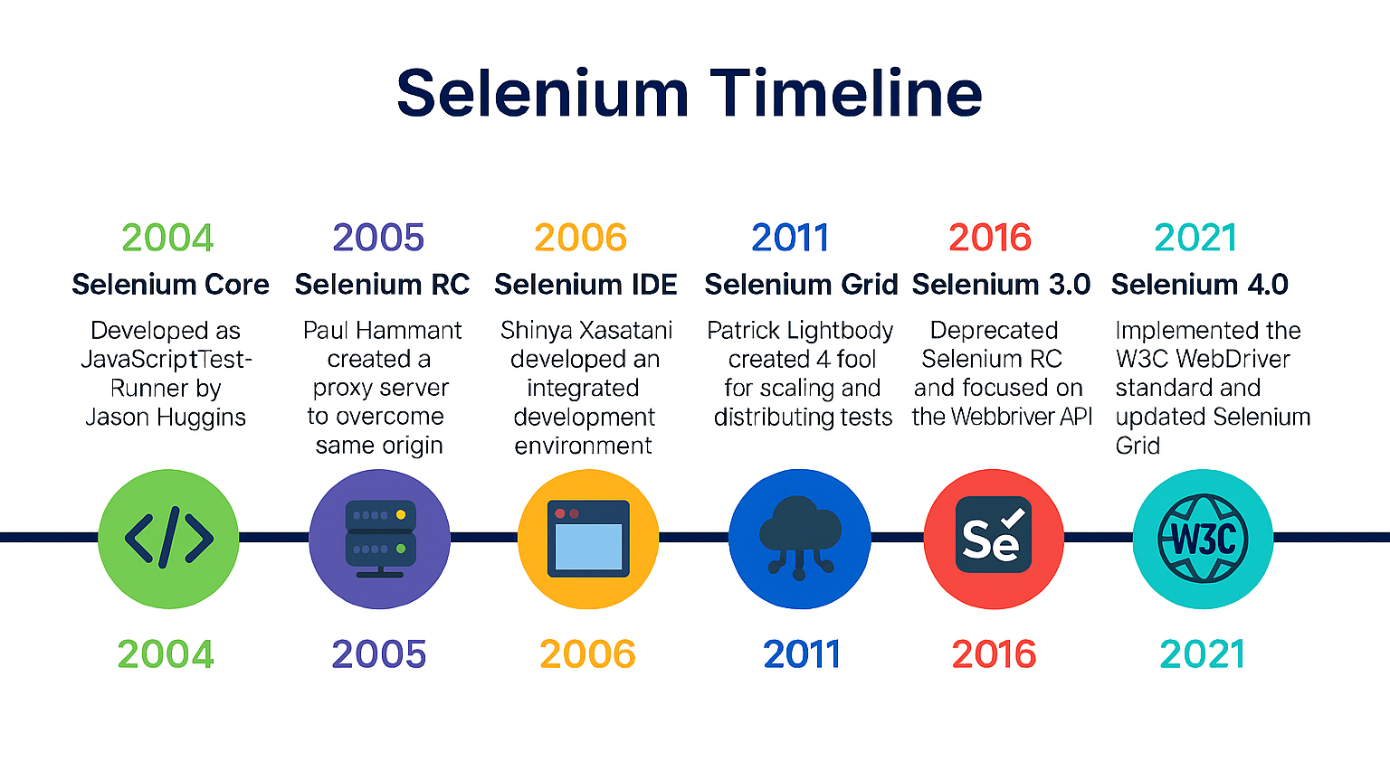

Slide 8
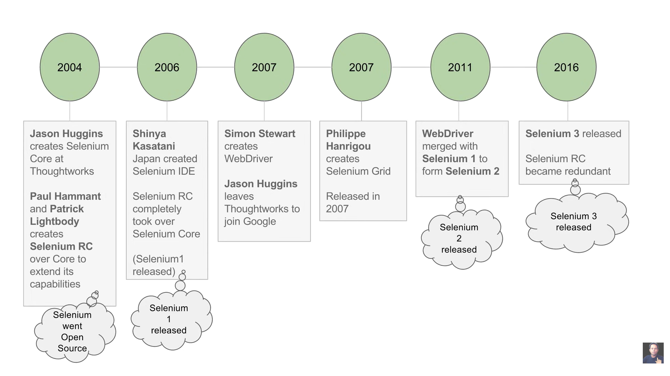
The latest stable version of Selenium is 4.38.0, released on October 25, 2025.

Slide 9
FEATURE HIGHLIGHTS OF SELENIUM 4
Terminated native support to Opera and PhantomJS browsers
Selenium 4 introduced relative locators (enable you to locate web elements on a page based on their relationship to other elements)
Deprecated Desired Capabilities and replaced it with Options class
Added new methods to Action class

Slide 10
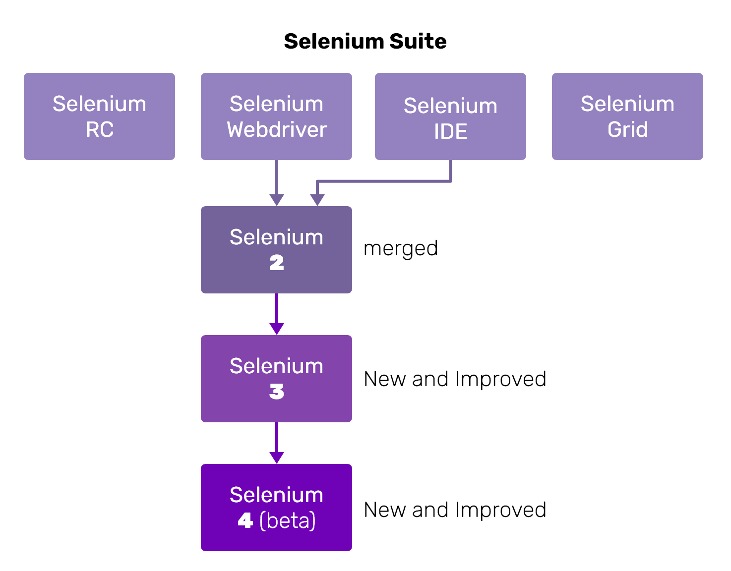
COMPONENTS OF SELENIUM

Slide 11
Selenium IDE (Integrated Development Environment)
Type: Record and Playback tool.
Used for: Beginners and quick bug reproduction scripts.
Browser Support: Firefox and Chrome (as extensions).
Key Features:
Easy to use.
No programming knowledge required.
Generates code in Selenium-supported languages (Java, Python, etc.).
2. Selenium WebDriver
Type: Core component for browser automation.
Used for: Creating complex and robust automation scripts.
Supports: Multiple programming languages – Java, Python, C#, Ruby, JavaScript.
Browser Support: Chrome, Firefox, Safari, Edge, Opera.
Key Features:
Interacts directly with the browser.
No dependency on an external server (unlike Selenium RC).
Supports dynamic web elements and advanced user interactions.

Slide 12
3. Selenium Grid
Type: Distributed test execution tool.
Used for: Running tests on multiple machines and browsers in parallel.
Key Features:
Reduces test execution time.
Supports parallel and cross-browser testing.
Central hub manages multiple nodes.
4. Selenium RC (Remote Control) [Deprecated]
Type: Older version of Selenium for browser automation.
Key Features:
Required a server to inject JavaScript into browsers.
Superseded by Selenium WebDriver due to better architecture and performance.
5. Selenium Client API
Used for: Writing test scripts in multiple programming languages.
Languages Supported: Java, Python, C#, Ruby, JavaScript.
Key Feature: Allows flexibility for testers to write in their preferred language.

Slide 13
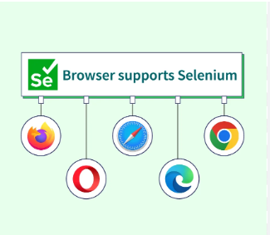
SELENIUM SUPPORTED BROWSER

Slide 14
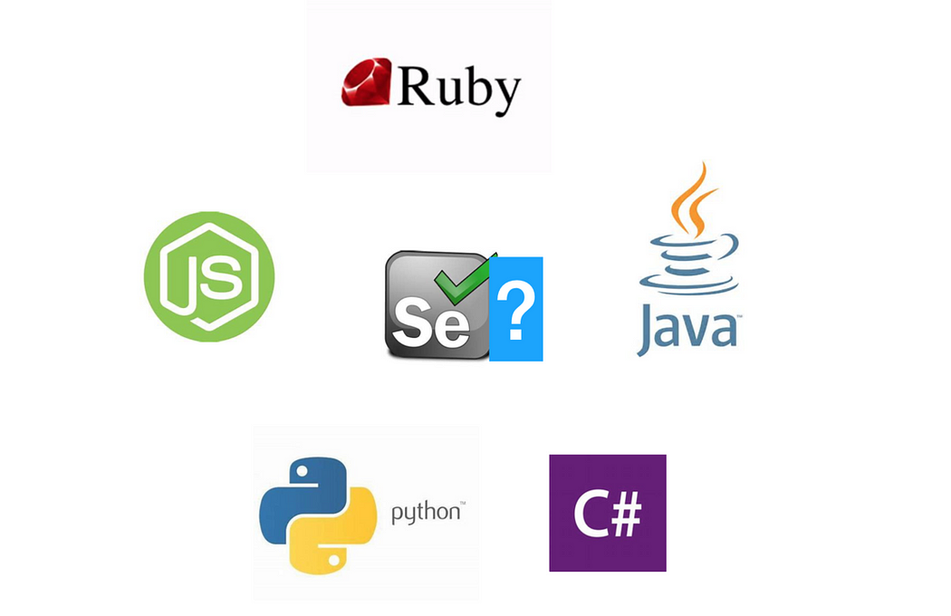
selenium supported languages

Slide 15
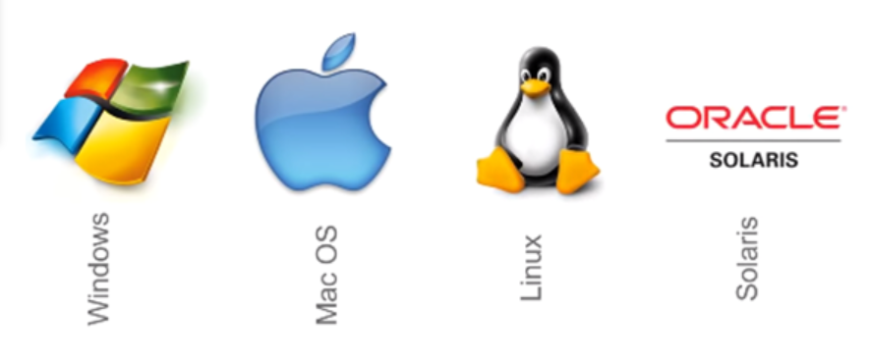
selenium supported OS

Slide 16
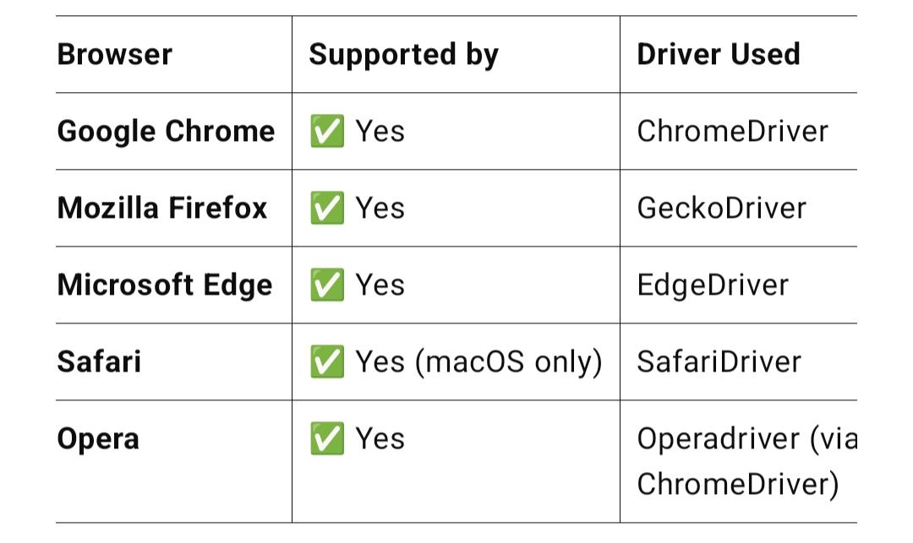
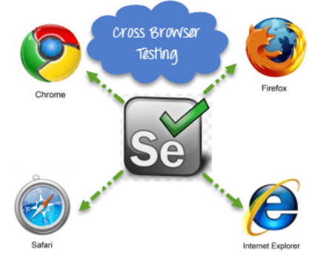
✅ Selenium: Cross-Browser & Cross-Platform Compatibility
Selenium is widely used because of its ability to support multiple browsers and run on different operating systems (platforms).
🔹 Cross-Browser Compatibility
Selenium supports automation across all major browsers:
Note: Each browser requires its specific WebDriver executable to interact with Selenium.

Slide 17
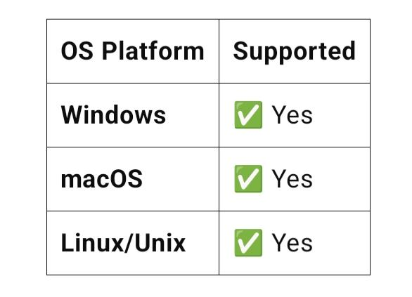
🔹 Cross-Platform Compatibility
Selenium supports execution on major operating systems:
OS Platform Supported
With Selenium Grid, you can run tests remotely on multiple OS-browser combinations from a central hub, ensuring full compatibility testing.

Slide 18
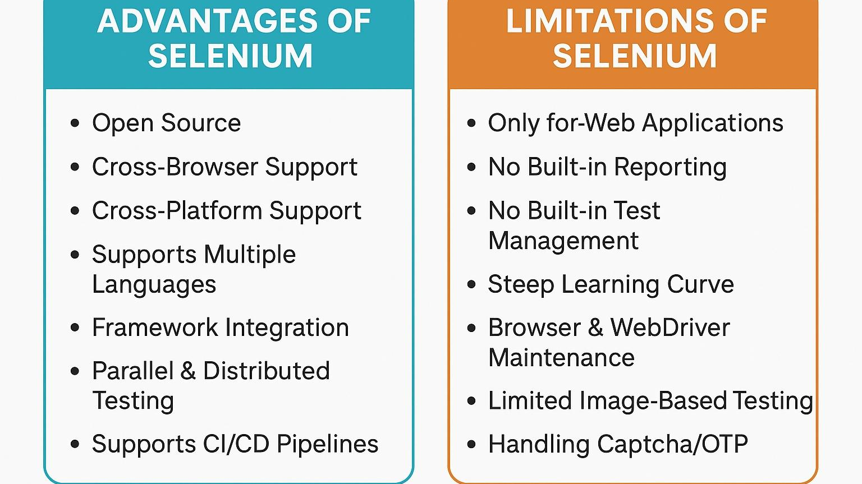

Slide 19
SELENIUM WEBDRIVER
Selenium WebDriver is a powerful tool in the Selenium suite used for automating web application testing. It allows you to programmatically control web browsers, simulating user actions such as clicking, typing, navigating, and more.
Definition:Selenium WebDriver is an open-source API used to automate web browser interactions by communicating directly with the browser.
It supports various browsers and programming languages, making it suitable for cross-browser and cross-platform automated testing.

Slide 20
WebDriver is the interface that allows communication between your test scripts and the browser.
API (Application Programming Interface) is a set of methods and classes that allow developers to interact with a system or software.
Selenium offers language-specific APIs (Java, Python, C#, Ruby, etc.) so you can write automation scripts in your preferred language.
These APIs expose WebDriver commands like get(), click(), sendKeys(), etc., which internally communicate with the browser via the WebDriver protocol.

Slide 21
FAQ??
Why should I learn selenium?
Do I need to learn a program language first?
Can I use selenium just for understanding concepts
and use other tools?
Any limitations in selenium?

